Slide 1

Recurrent Neural Networks I
Yao-Yi Chiang
Computer Science and Engineering
University of Minnesota
yaoyi@umn.edu
CC-BY
Attribution

Slide 2

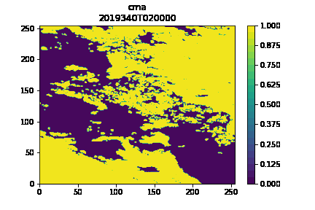
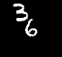
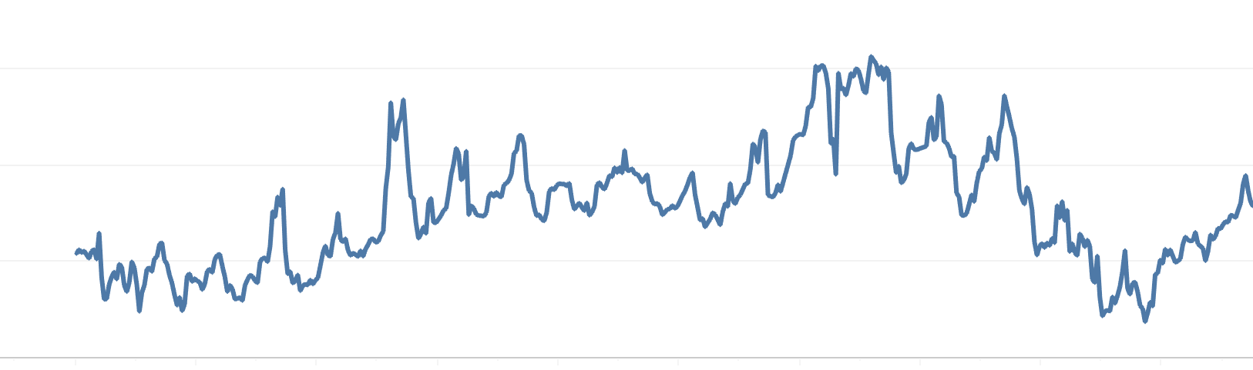
Sequences
Sequences are everywhere
Natural language
“This morning I took my cat for a walk”
Audio and video
Sensor observations (e.g., air quality, traffic, noise)
Cloud Mask from Weather4cast
150
100
PM_{2.5} values
50
Moving MNIST
0
Aug 15
Aug 20
Aug 25
Aug 30
Time

Slide 3
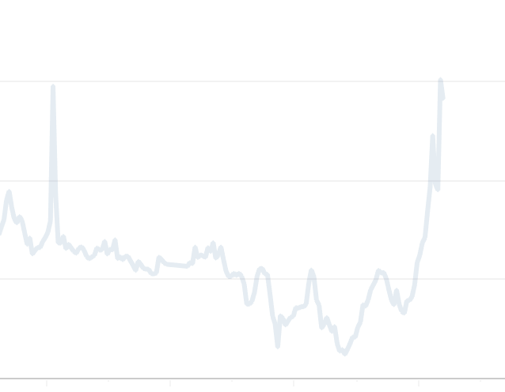
Sequence Modeling
Sequence modeling is the task of predicting what comes next
E.g., “This morning I took my cat for a walk ”
E.g., given historical air quality, forecast air quality in next couple of hours
given previous words
predict the next word
What is the air quality in future?
150
100
PM_{2.5} values
50
0
Aug 15
Aug 20
Aug 25
Aug 30
Time

Slide 4
A Sequence Modeling Example Predict the Next Word
Idea #1: Use a fixed window
“This morning I took my cat for a walk ”
given previous two words
predict the next word

Slide 5
A Sequence Modeling Example Predict the Next Word
Idea #1: Use a fixed window
“This morning I took my cat for a walk ”
Limitation: Cannot model long-term dependencies
E.g., “France is where I grew up, but I now live in Boston. I speak fluent ___.”
given previous two words
predict the next word

Slide 6
A Sequence Modeling Example Predict the Next Word
Idea #1: Use a fixed window
“This morning I took my cat for a walk ”
Limitation: Cannot model long-term dependencies
E.g., “France is where I grew up, but I now live in Boston. I speak fluent ___.”
We need information from the distant past to accurately predict the correct word
given previous two words
predict the next word

Slide 7
A Sequence Modeling Example Predict the Next Word
Idea #2: Use entire sequence as set of counts
“This morning I took my cat for a walk ”
predict the next word

Slide 8
A Sequence Modeling Example Predict the Next Word
Idea #2: Use entire sequence as set of counts
“This morning I took my cat for a walk ”
Bag-of-words model
Define a vocabulary and initialize a zero vector where each element represents for each word
Compute word frequency and update the correspond position in the vector
[0 1 0 0 1 0 1 … … 0 0 1 1 0 0 0 1 0 ]
Use the vector for prediction
predict the next word
Here 1 is the count for the work “a”

Slide 9
A Sequence Modeling Example Predict the Next Word
Idea #2: Use entire sequence as set of counts
“This morning I took my cat for a walk ”
Limitation: Counts don’t preserve order
“The food was good, not bad at all.” VS. “The food was bad, not good at all.”
We need to preserve the information about order
predict the next word

Slide 10
A Sequence Modeling Example Predict the Next Word
Idea #3: Use a big fixed window
“This morning I took my cat for a walk ”
One-hot encoding
[1 0 0 0 0 0 0 0 0 0 0 0 0 1 0 0 0 1 0 0 0 … …]
Use the one-hot encoding vector for prediction
given these words
predict the next word
this
morning
I

Slide 11
A Sequence Modeling Example Predict the Next Word
Idea #3: Use a big fixed window
“This morning I took my cat for a walk ”
Limitation: Each of these inputs has a separate parameter
“I took my cat this morning for a walk”
[0 0 0 1 0 0 0 … … 1 0 0 0 0 0 0 0 0 0 0 0 0 1 … …]
Things we learn about the sequence should be applicable when they appear elsewhere in the sequence
given these words
predict the next word
I
this
morning

Slide 12
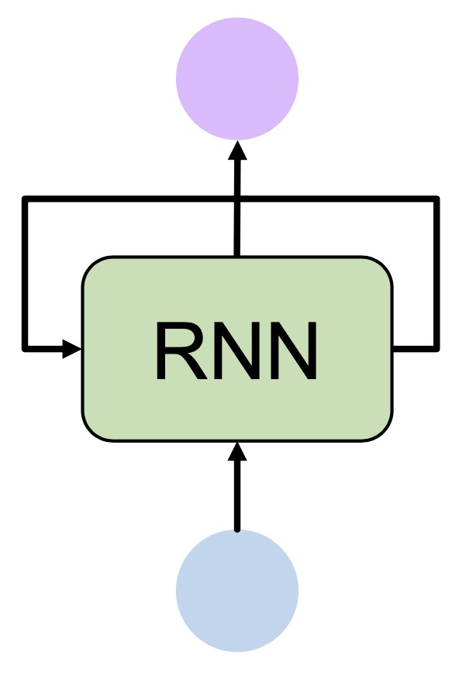
Sequence Modeling
To model sequences, we need to:
Handle variable-length sequences
Track long-term dependencies
Maintain information about order
Share parameters across the sequence
Solution:
Recurrent Neural Networks (RNNs)

Slide 13
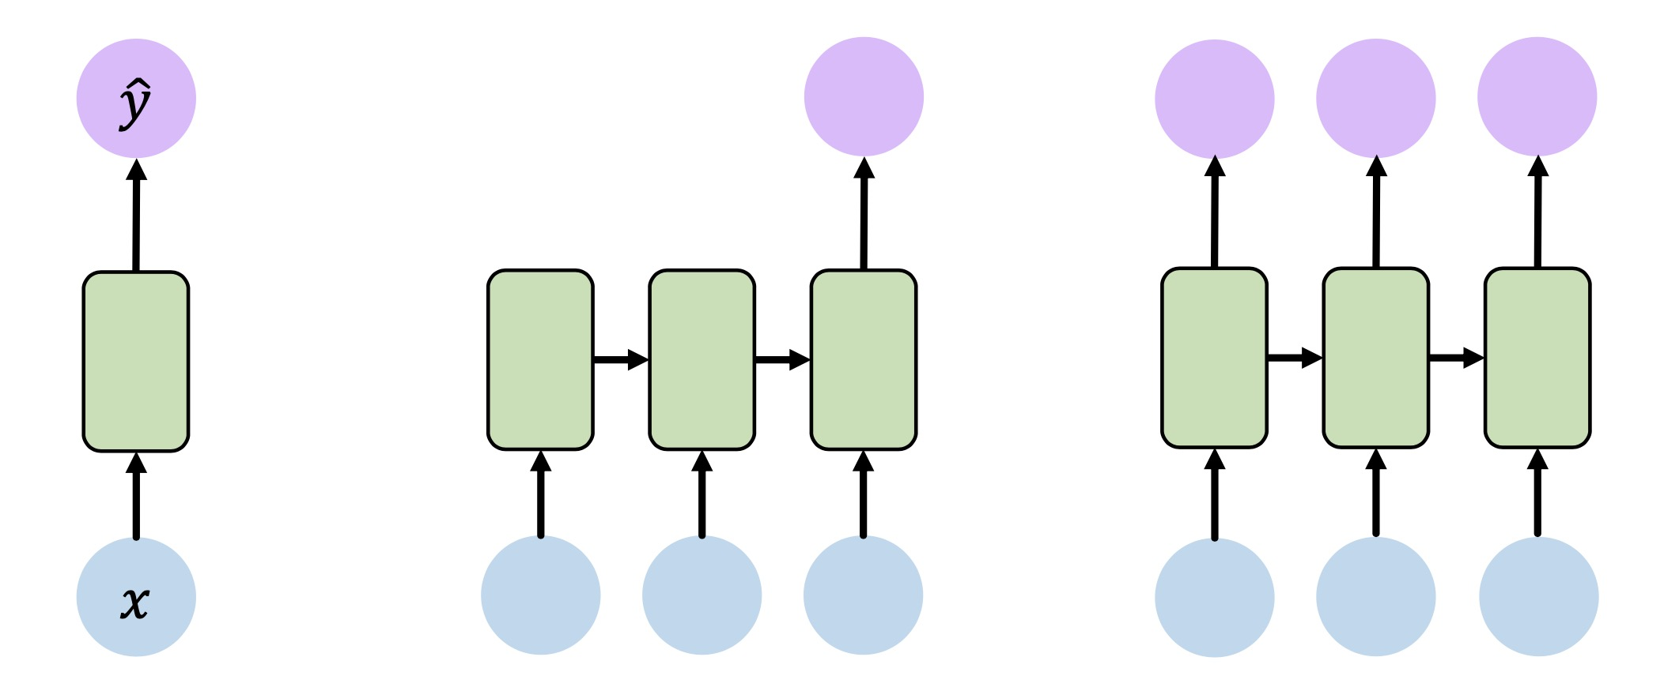
Standard Feed-Forward Neural Network
One to One
“Vanilla” neural network

Slide 14
Recurrent Neural Networks
One to One
“Vanilla” neural network
Many to One
Sentiment Classification

Slide 15
Recurrent Neural Networks
... and many other architectures and applications
One to One
“Vanilla” neural network
Many to One
Sentiment Classification
Many to Many
Music Generation

Slide 16
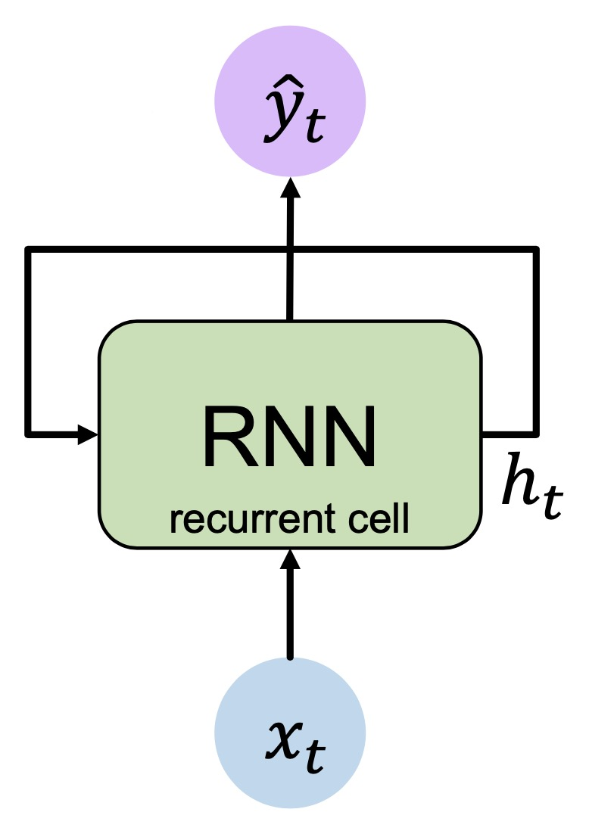
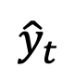
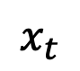
A Recurrent Neural Network (RNN)
$${\hat{y}}_{t}$$
output vector
$$x_{t}$$
input vector

Slide 17
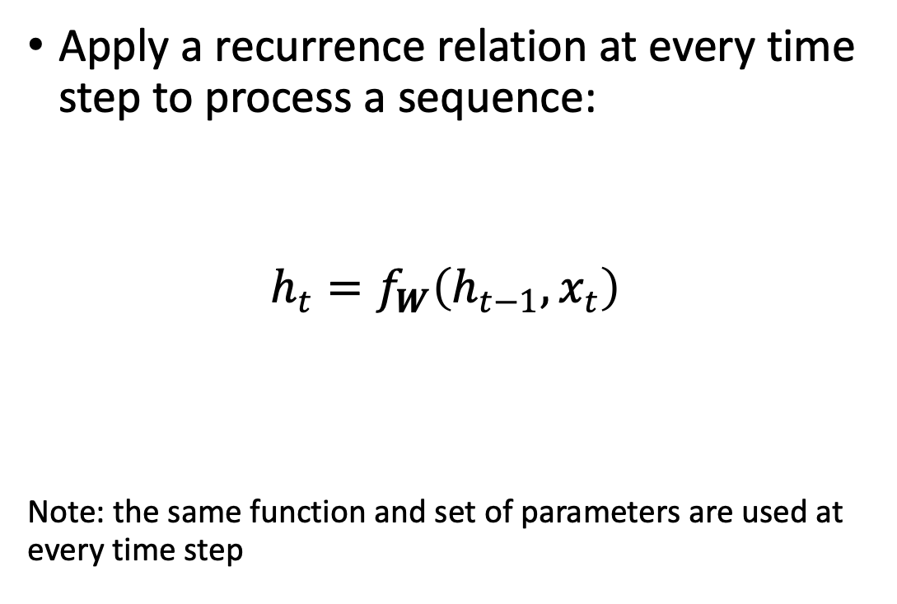
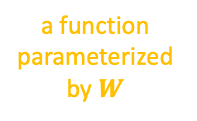
A Recurrent Neural Network (RNN)
Apply a recurrence relation at every time step to process a sequence:
$$h_{t}=f_{W}\left(h_{t−1},x_{t}\right)$$
Note: the same function and set of parameters are used at every time step
$${\hat{y}}_{t}$$
output vector
cell state
old state
a function parameterized by $W$
current input
$$x_{t}$$
input vector
https://r2rt.com/non-zero-initial-states-for-recurrent-neural-networks.html

Slide 18
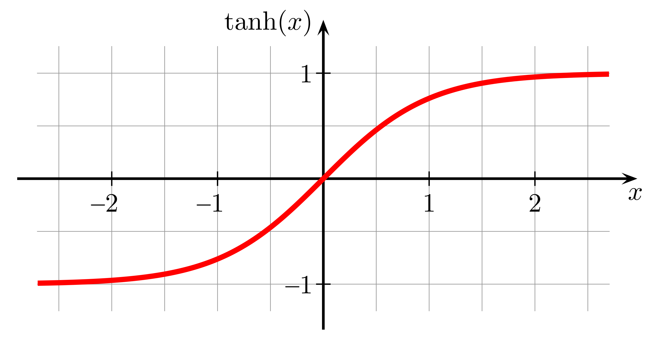
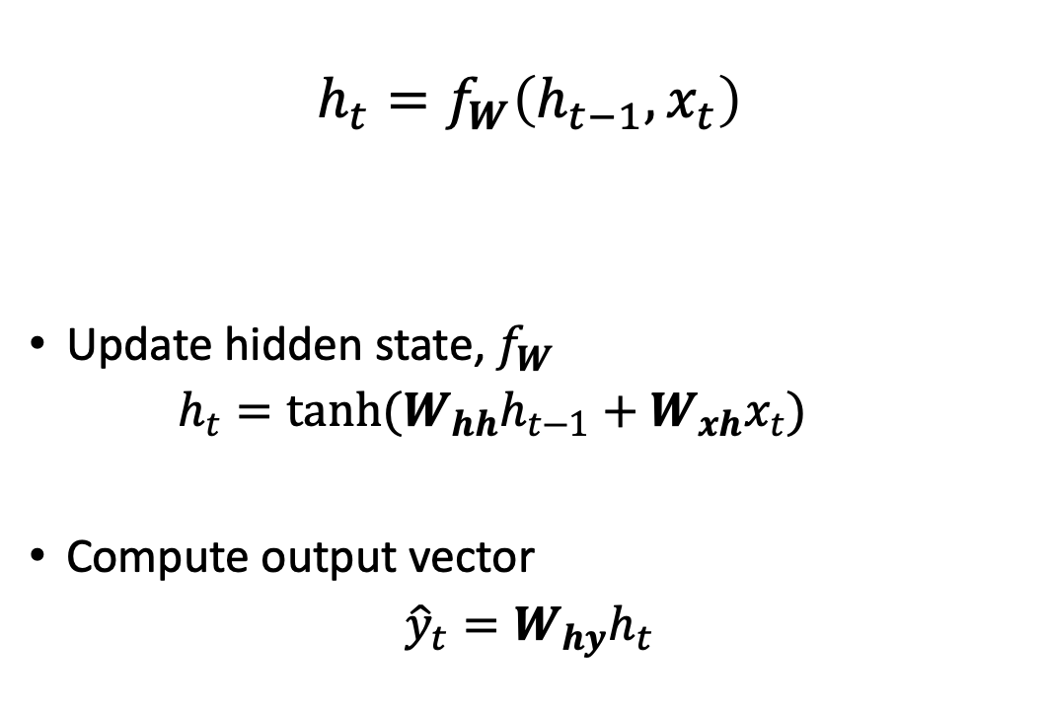
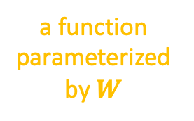
RNN: State Update and Output
cell state
old state
$$h_{t}=f_{W}\left(h_{t−1},x_{t}\right)$$
Update hidden state, $f_{W}$
$$h_{t}=\tanh{(W_{hh}h_{t−1}+W_{xh}x_{t})}$$
Compute output vector
$${\hat{y}}_{t}=W_{hy}h_{t}$$
$${\hat{y}}_{t}$$
output vector
a function parameterized by $W$
current input
$$x_{t}$$
input vector

Slide 19
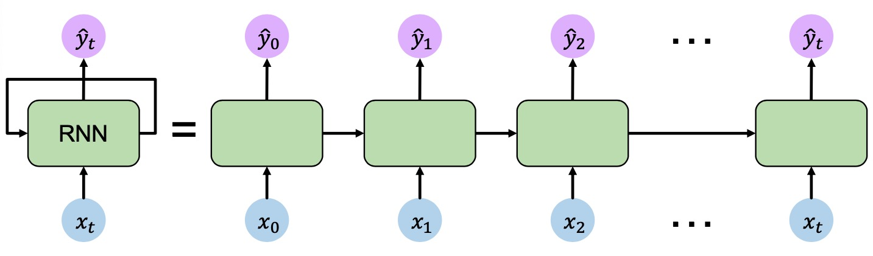
RNN: Computational Graph Across Time
Represent as computational graph unrolled across time

Slide 20
RNN: Computational Graph Across Time
Represent as computational graph unrolled across time

Slide 21
RNN: Computational Graph Across Time
Represent as computational graph unrolled across time

Slide 22
RNN: Computational Graph Across Time
Represent as computational graph unrolled across time

Slide 23
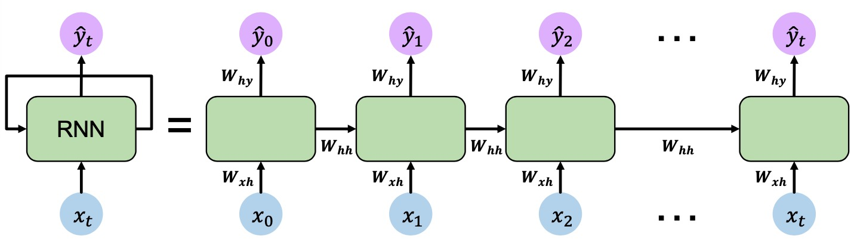
RNN: Computational Graph Across Time
Re-use the same weight matrices at every time step

Slide 24
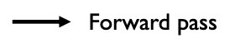
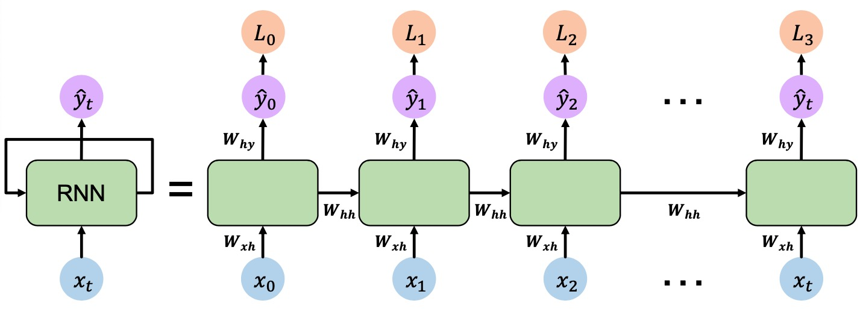
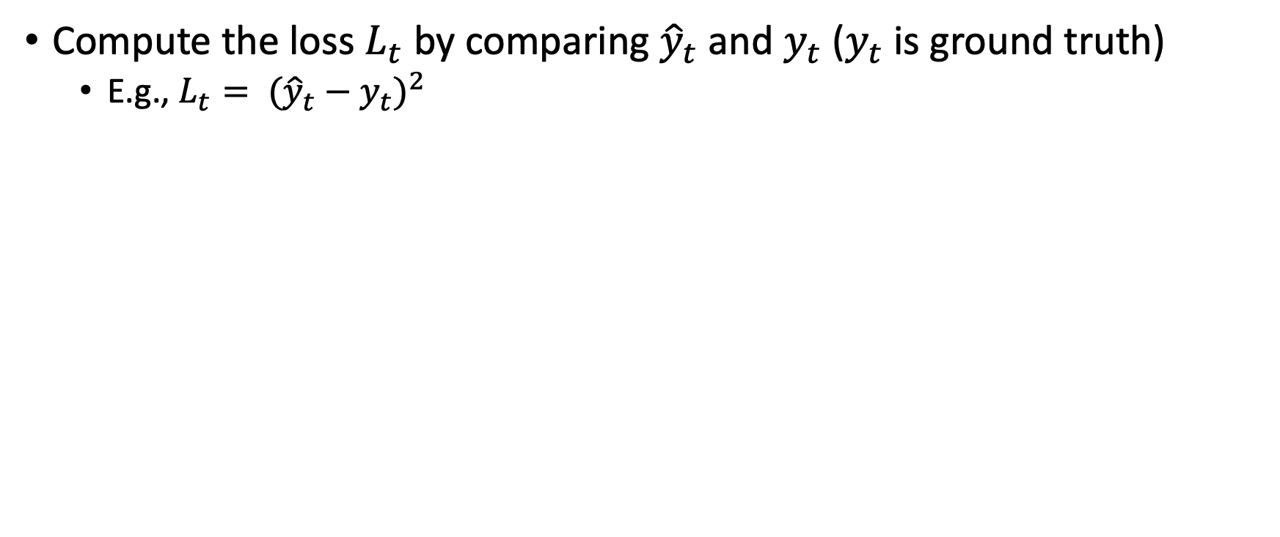
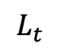
RNN: Computational Graph Across Time
Compute the loss $L_{t}$ by comparing ${\hat{y}}_{t}$ and $y_{t}$ ($y_{t}$is ground truth)
E.g., $L_{t}= {({{\hat{y}}_{t}−y}_{t})}^{2}$
$$L_{t}$$

Slide 25
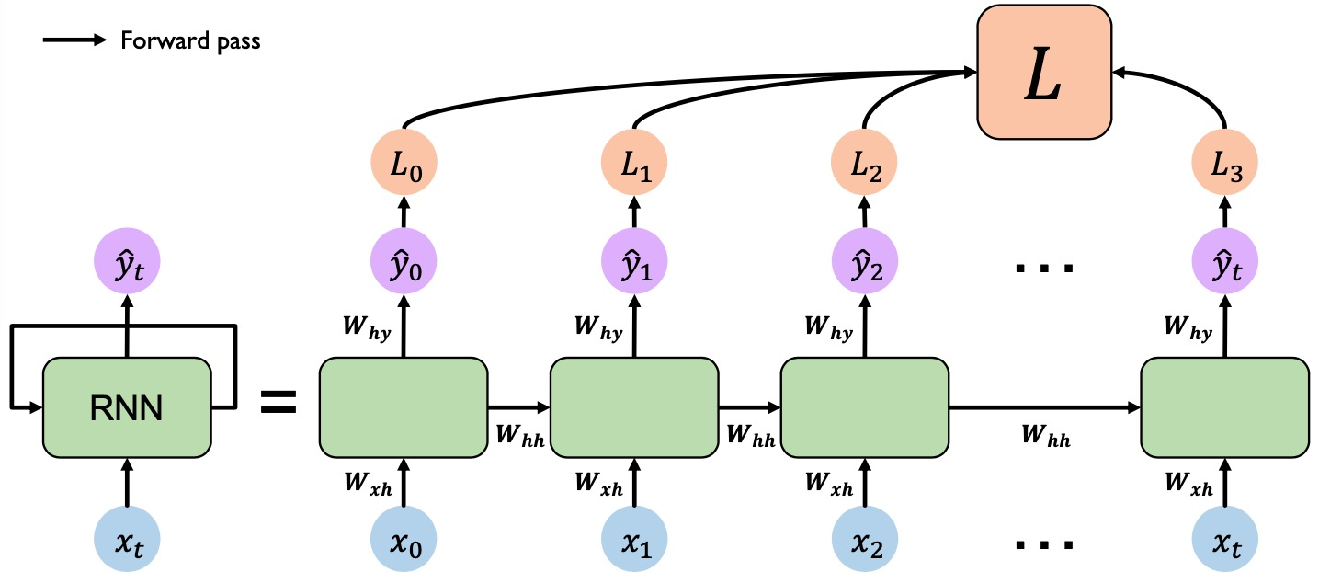
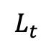
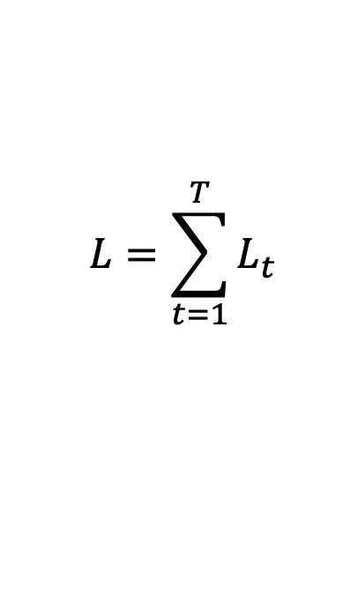
RNN: Computational Graph Across Time
$$L=\sum_{t=1}^{T}{L_{t}}$$
Total loss
$$L_{t}$$
$$L_{t}$$

Slide 26
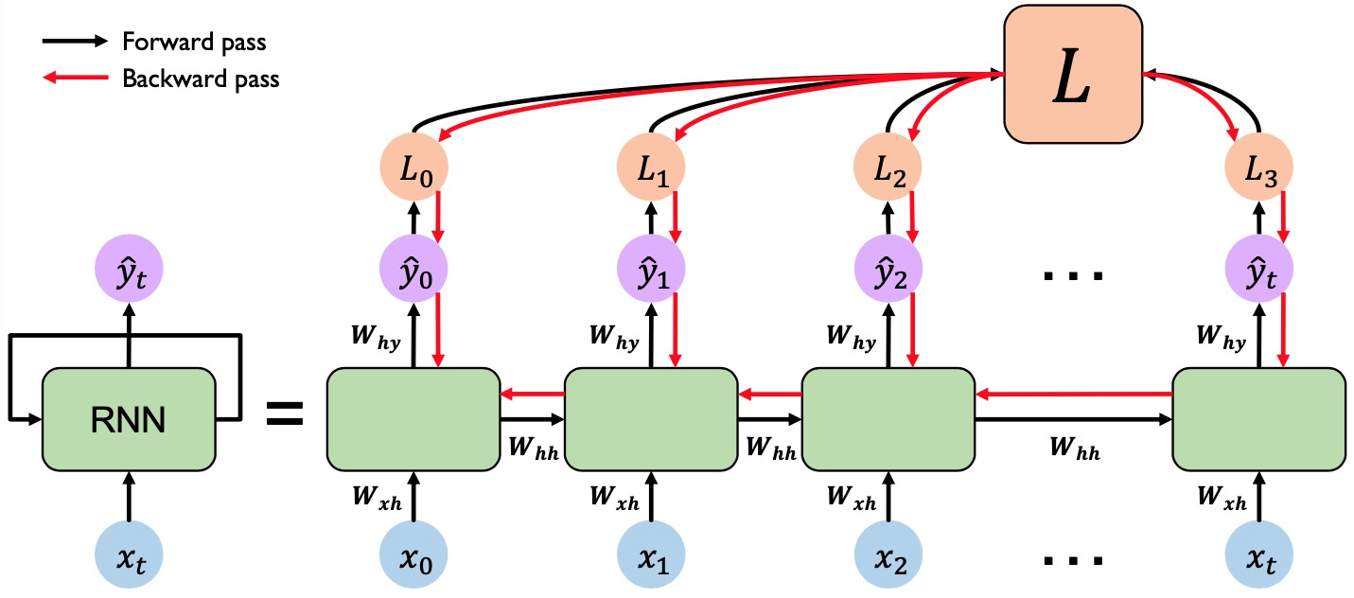
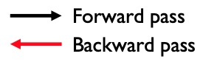
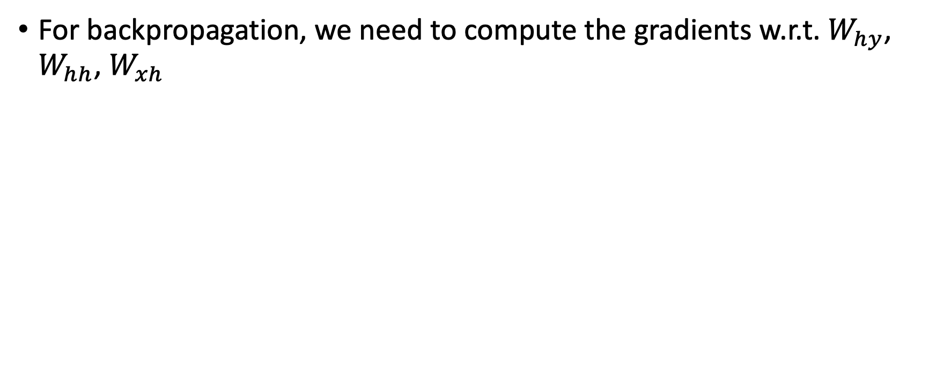
RNN: Backpropagation Through Time
For backpropagation, we need to compute the gradients w.r.t. $W_{hy}$, $W_{hh}$, $W_{xh}$
$$L_{t}$$

Slide 27
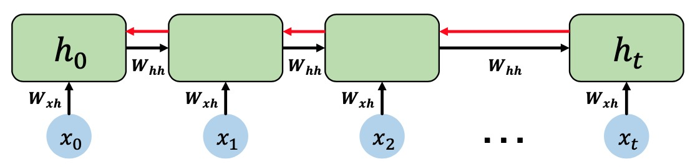
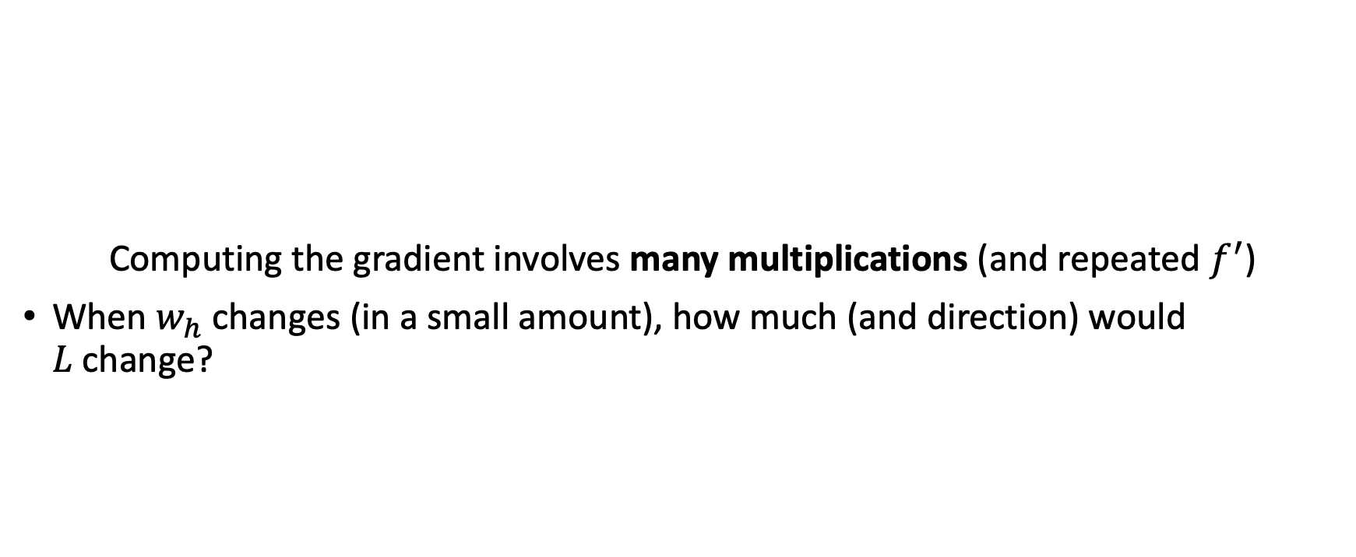
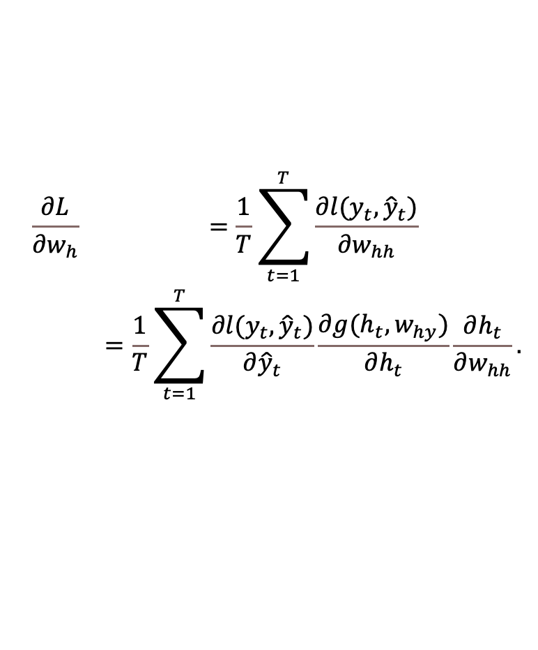
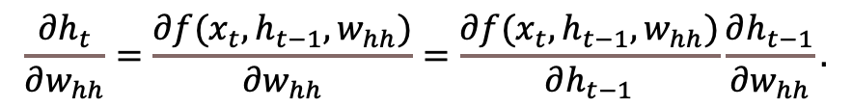
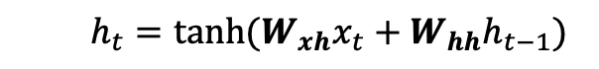
RNN: Backpropagation Through Time
Computing the gradient involves many multiplications (and repeated $f^{′}$)
When $w_{h}$ changes (in a small amount), how much (and direction) would $L$change?
$$\begin{aligned}&\begin{matrix}\frac{∂L}{∂w_{h}} & =\frac{1}{T}\sum_{t=1}^{T}{\frac{∂l(y_{t},{\hat{y}}_{t})}{∂w_{hh}}} \\ & =\frac{1}{T}\sum_{t=1}^{T}{\frac{∂l(y_{t},{\hat{y}}_{t})}{∂{\hat{y}}_{t}}\frac{∂g(h_{t},w_{hy})}{∂h_{t}}\frac{∂h_{t}}{∂w_{hh}}}.\end{matrix}\end{aligned}$$
For example,
$$h_{t}=\tanh{(W_{xh}x_{t}+W_{hh}h_{t−1})}$$
$$\frac{∂h_{t}}{∂w_{hh}}=\frac{∂f(x_{t},h_{t−1},w_{hh})}{∂w_{hh}}=\frac{∂f(x_{t},h_{t−1},w_{hh})}{∂h_{t−1}}\frac{∂h_{t−1}}{∂w_{hh}}.$$
https://d2l.ai/chapter_recurrent-neural-networks/bptt.html

Slide 28
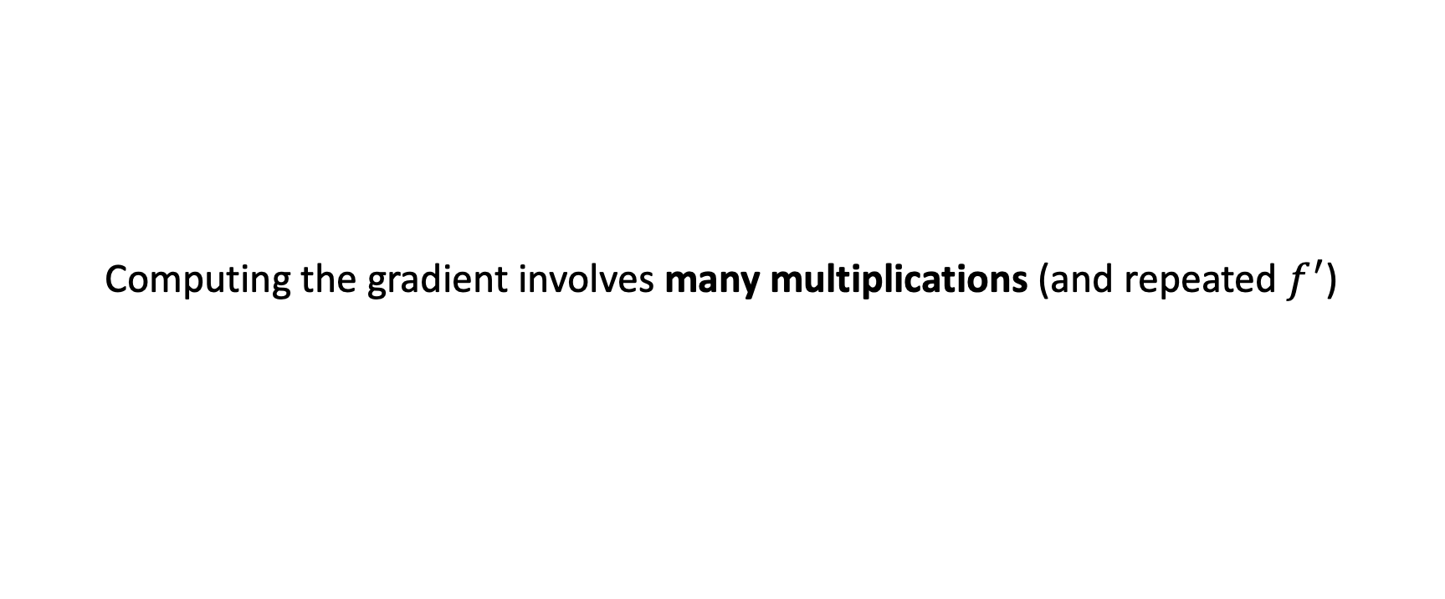
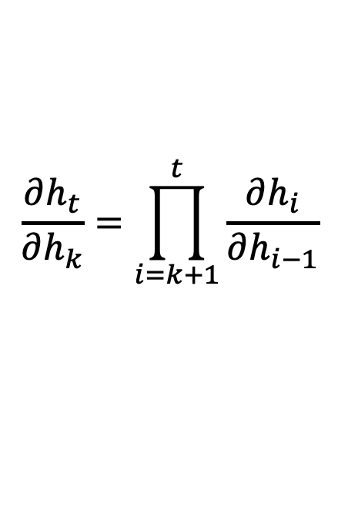
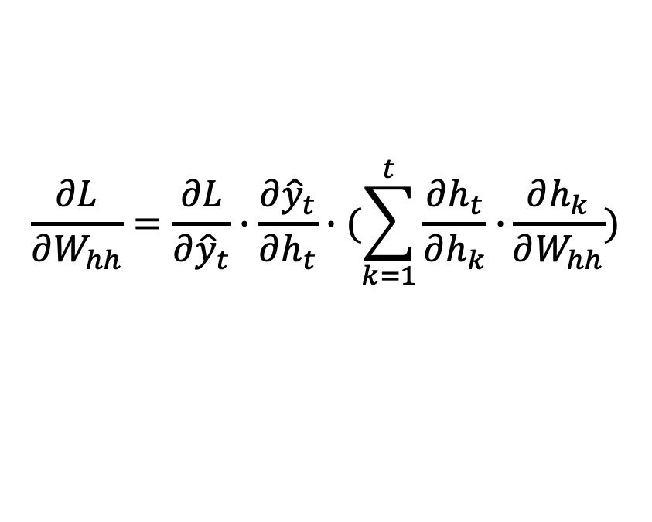
RNN: Backpropagation Through Time
Computing the gradient involves many multiplications (and repeated $f^{′}$)
$$\frac{∂L}{∂W_{hh}}=\frac{∂L}{∂{\hat{y}}_{t}}∙\frac{∂{\hat{y}}_{t}}{∂h_{t}}∙(\sum_{k=1}^{t}{\frac{∂h_{t}}{∂h_{k}}∙}\frac{∂h_{k}}{∂W_{hh}})$$
For example,
$$\frac{∂h_{t}}{∂h_{k}}=\prod_{i=k+1}^{t}{\frac{∂h_{i}}{∂h_{i−1}}}$$
https://d2l.ai/chapter_recurrent-neural-networks/bptt.html

Slide 29
Gradient Flow: Exploding Gradients
Case 2: Many values are < 1
Vanishing gradients
Trick 1: Activation functions
Trick 2: Weight initialization
Trick 3: Network architecture
Case 1: Many values are > 1
Exploding gradients
Trick : Gradient clipping to scale big gradients

Slide 30
Gradient Flow: Vanishing Gradients
Case 1: Many values are > 1
Exploding gradients
Trick 1: Gradient clipping to scale big gradients
Case 2: Many values are < 1
Vanishing gradients
Trick 1: Activation functions
Trick 2: Network architecture

Slide 31
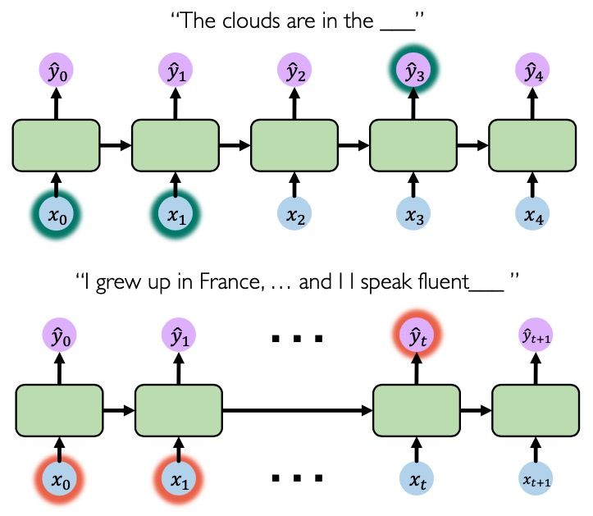
Vanishing Gradients
What causes vanishing gradients?
Multiply many small numbers together
Further back time steps would have smaller and smaller gradients
Fail to capture long-term dependencies

Slide 32
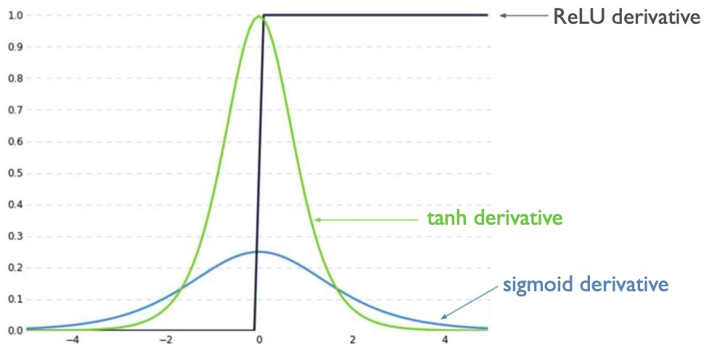
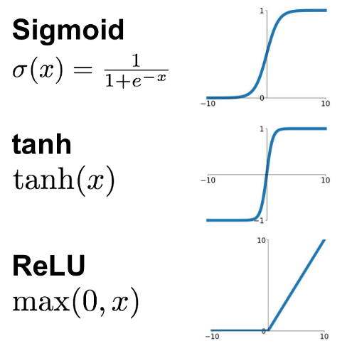
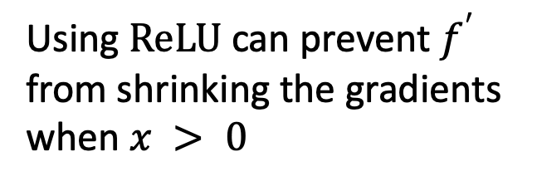
Trick 1: Activation Functions
Using $ReLU$ can prevent $f^{′}$ from shrinking the gradients when $x > 0$

Slide 33
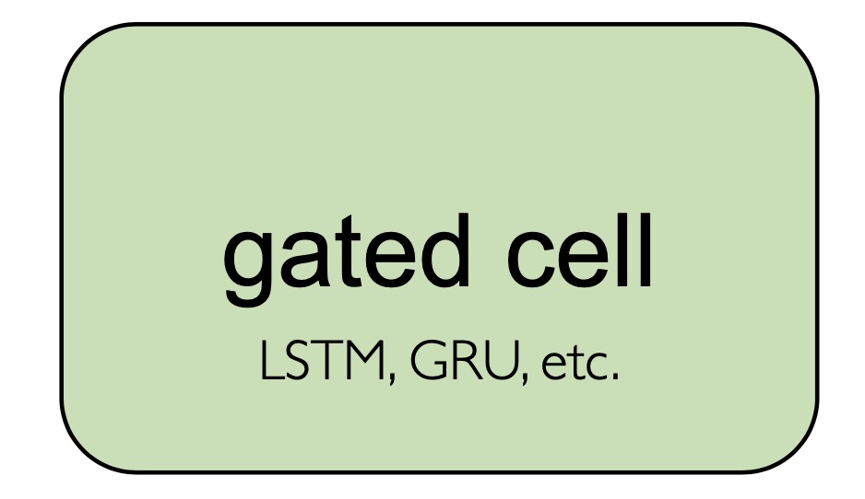
Trick 2: Network Architecture – Gated Cells
Use a more complex recurrent unit with gates to control what information is passed through
Long Short-Term Memory (LSTM) networks rely on gated cells to track information throughout many time steps.

Slide 34
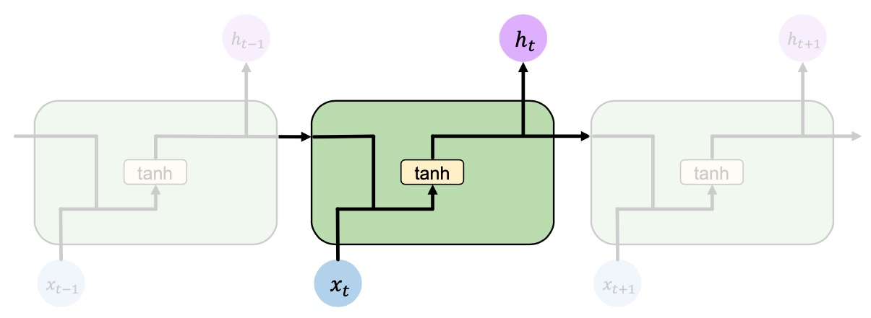

Standard RNNs
In a standard RNN, recurrent modules contain simple computation
https://colah.github.io/posts/2015-08-Understanding-LSTMs/

Slide 35
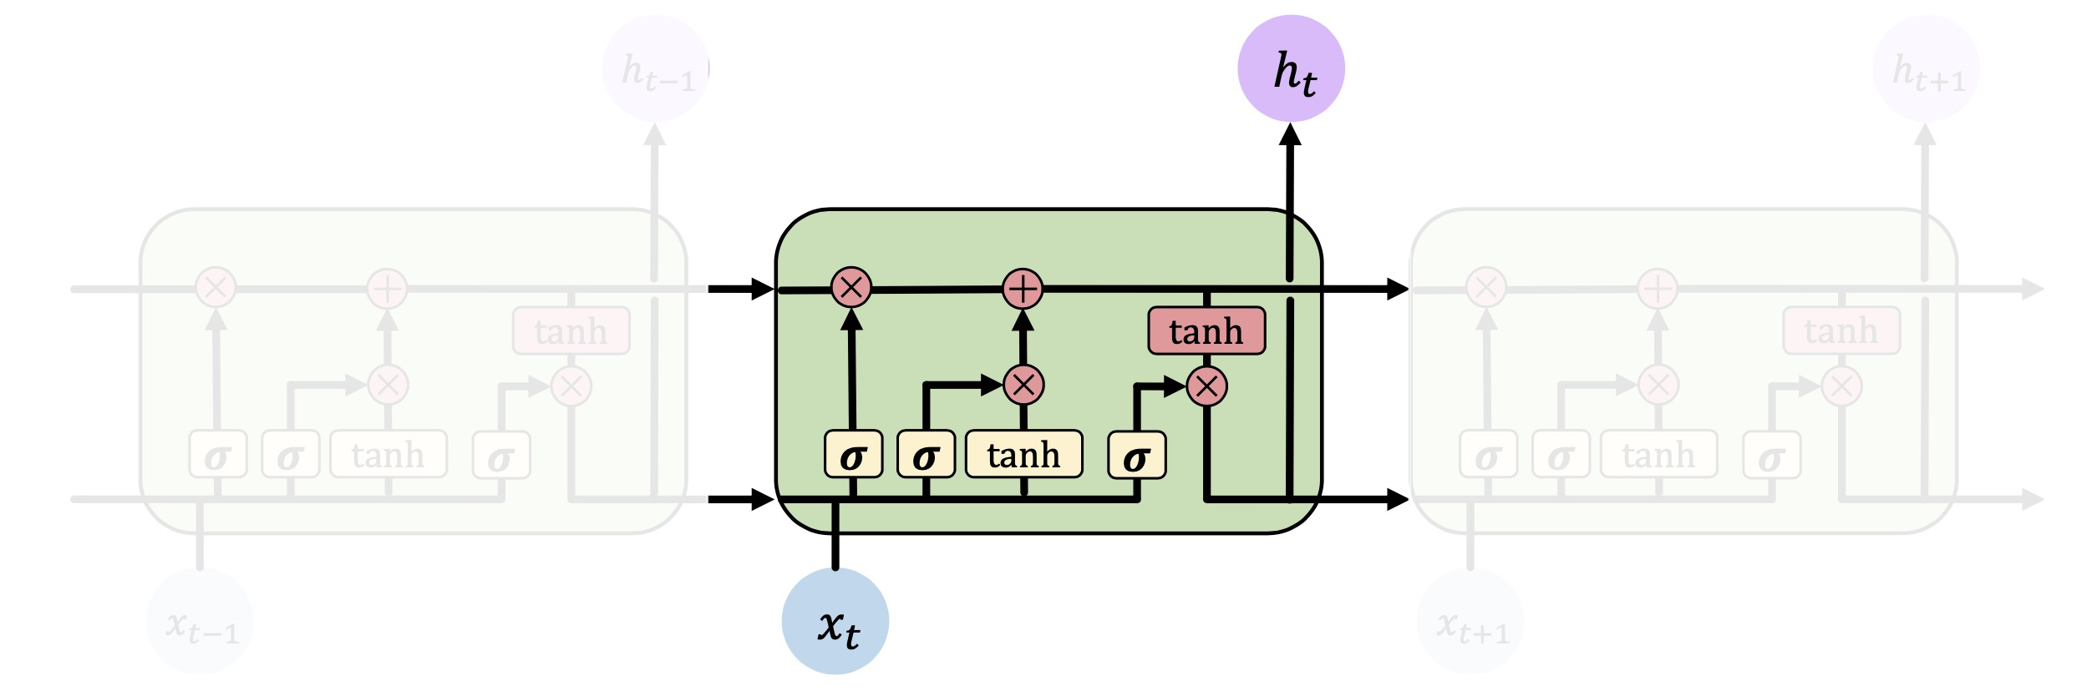
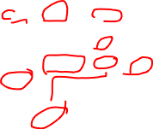
Long Short-Term Memory (LSTM)
In an LSTM network, recurrent modules contain gated cells that control the information flow [Hochreiter et al., 1997]
https://colah.github.io/posts/2015-08-Understanding-LSTMs/

Slide 36
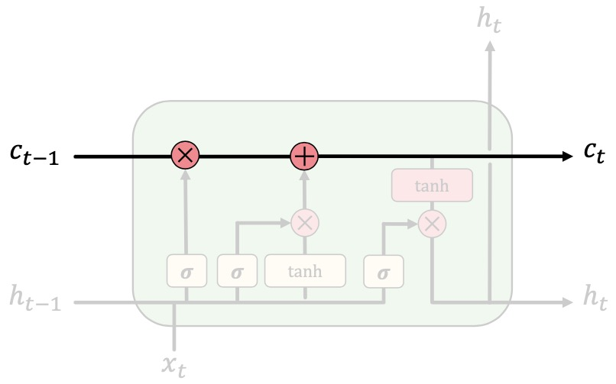
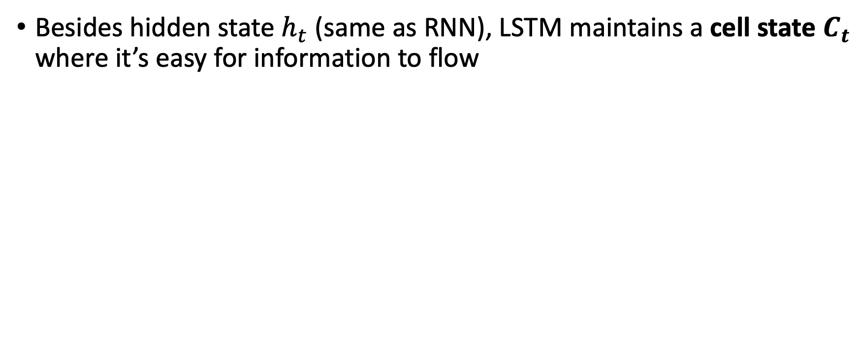
Long Short-Term Memory (LSTM)
Besides hidden state $h_{t}$ (same as RNN), LSTM maintains a cell state $C_{t}$ where it’s easy for information to flow

Slide 37
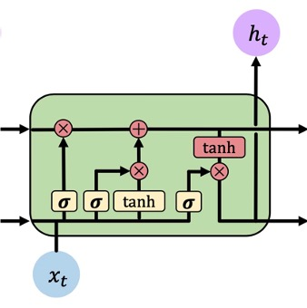
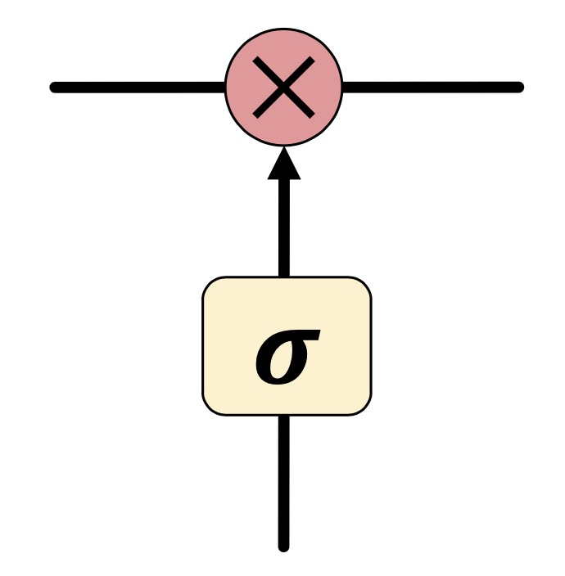
Long Short-Term Memory (LSTM)
Information is added or removed to cell state through structures called gates
Gates optionally let information through, via a sigmoid layer and pointwise multiplication

Slide 38
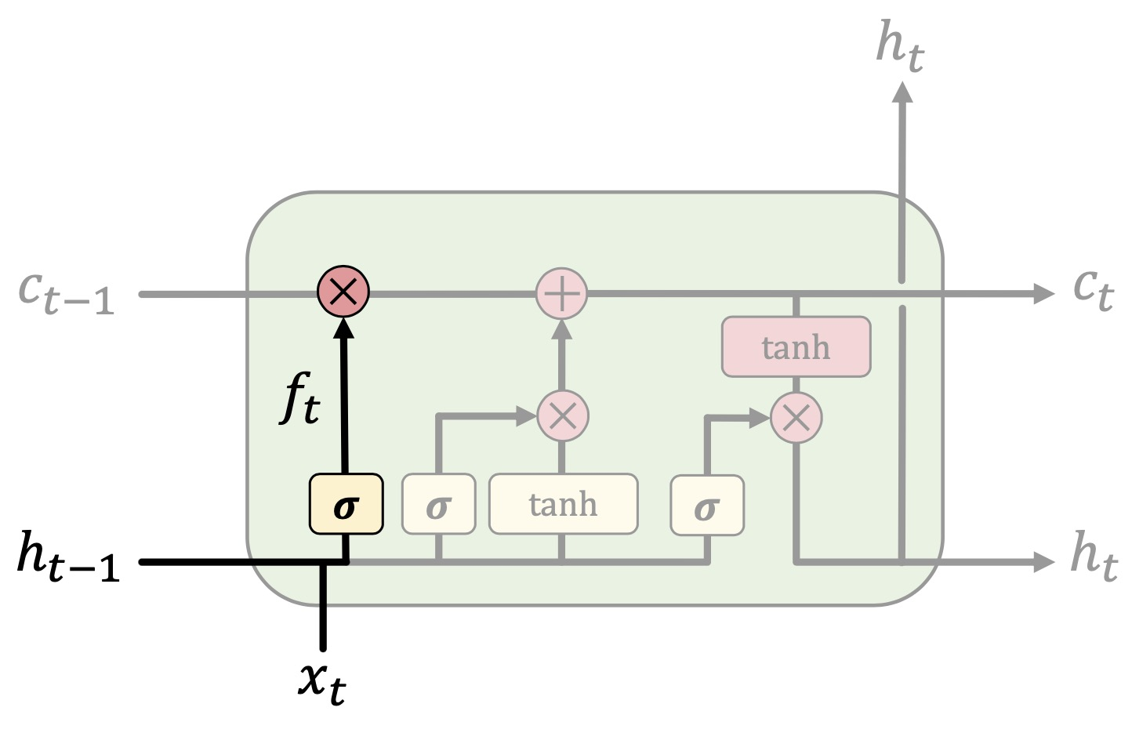
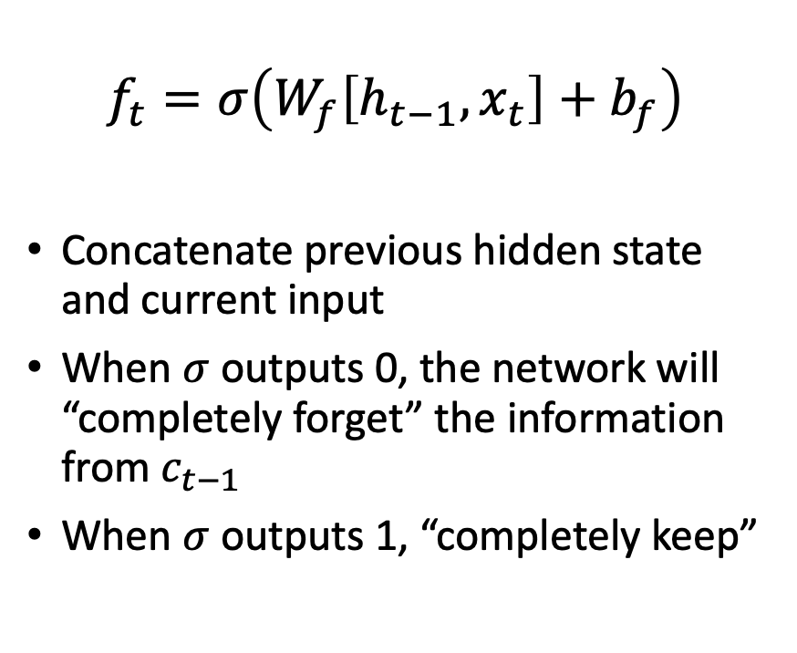
LSTM: Forget Irrelevant Information
$$f_{t}=σ\left(W_{f}\left[h_{t−1},x_{t}\right]+b_{f}\right)$$
Concatenate previous hidden state and current input
When $σ$ outputs 0, the network will “completely forget” the information from $c_{t−1}$
When $σ$ outputs 1, “completely keep”

Slide 39
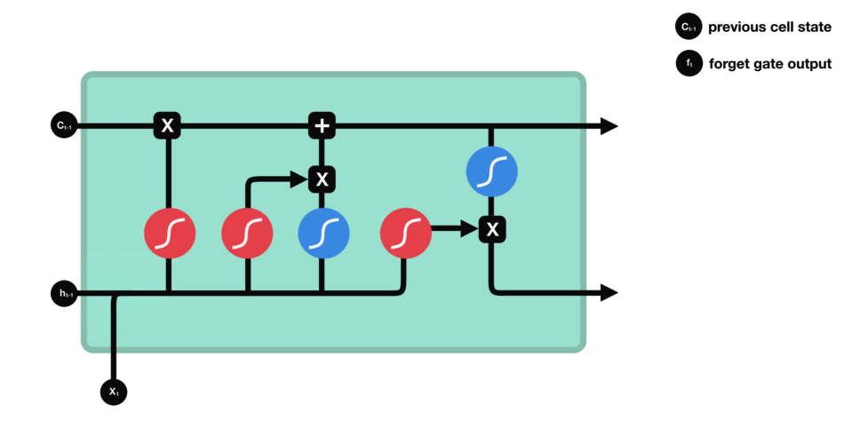
LSTM: Forget Irrelevant Information
$$f_{t}=σ\left(W_{f}\left[h_{t−1},x_{t}\right]+b_{f}\right)$$
Concatenate previous hidden state and current input
When $σ$ outputs 0, the network will “completely forget” the information from $c_{t−1}$
When $σ$ outputs 1, “completely keep”
https://towardsdatascience.com/illustrated-guide-to-lstms-and-gru-s-a-step-by-step-explanation-44e9eb85bf21

Slide 40
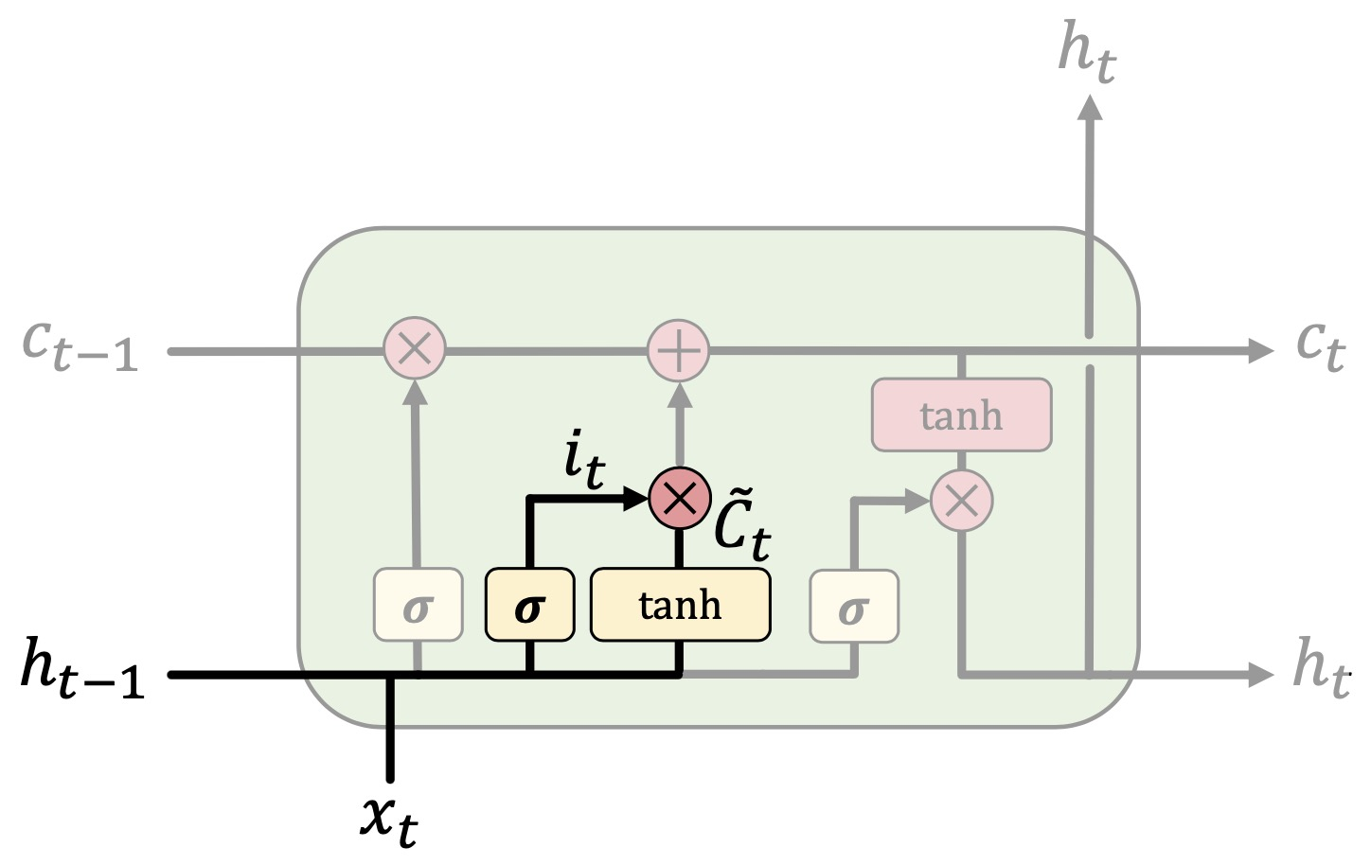

LSTM: Add New Information
$$i_{t}=σ\left(W_{i}\left[h_{t−1},x_{t}\right]+b_{i}\right)$$
$${\tilde{c}}_{t}=\tanh\left(W_{c}\left[h_{t−1},x_{t}\right]+b_{c}\right)$$
$σ$decides what values to update
$tanh$generates “candidate values” that could be added to cell state

Slide 41

LSTM: Add New Information
$$i_{t}=σ\left(W_{i}\left[h_{t−1},x_{t}\right]+b_{i}\right)$$
$${\tilde{c}}_{t}=\tanh\left(W_{c}\left[h_{t−1},x_{t}\right]+b_{c}\right)$$
$σ$decides what values to update
$tanh$generates “candidate values” that could be added to cell state
https://towardsdatascience.com/illustrated-guide-to-lstms-and-gru-s-a-step-by-step-explanation-44e9eb85bf21

Slide 42


LSTM: Update Cell State
$$c_{t}=f_{t}∗c_{t−1}+i_{t}{∗\tilde{c}}_{t}$$
$f_{t}∗c_{t−1}$ is to apply forget gate to previous cell state
$i_{t}{∗\tilde{c}}_{t}$ is to apply input gate to add new candidate values to cell state

Slide 43

LSTM: Update Cell State
$$c_{t}=f_{t}∗c_{t−1}+i_{t}{∗\tilde{c}}_{t}$$
$f_{t}∗c_{t−1}$ is to apply forget gate to previous cell state
$i_{t}{∗\tilde{c}}_{t}$ is to apply input gate to add new candidate values to cell state
https://towardsdatascience.com/illustrated-guide-to-lstms-and-gru-s-a-step-by-step-explanation-44e9eb85bf21

Slide 44


LSTM: Output Filtered Version of Cell State
$$o_{t}=σ\left(W_{o}\left[h_{t−1},x_{t}\right]+b_{o}\right)$$
$$h_{t}=o_{t}∗\tanh\left(c_{t}\right)$$
$σ$decides what parts of the cell state to output as current hidden state
$tanh$ squashes values between -1 and 1
$o_{t}∗\tanh\left(c_{t}\right)$ is to output filtered version of cell state
$h_{t}$ will be used to compute ${\hat{y}}_{t}$
https://towardsdatascience.com/illustrated-guide-to-lstms-and-gru-s-a-step-by-step-explanation-44e9eb85bf21

Slide 45


LSTM: Output Filtered Version of Cell State
$$o_{t}=σ\left(W_{o}\left[h_{t−1},x_{t}\right]+b_{o}\right)$$
$$h_{t}=o_{t}∗\tanh\left(c_{t}\right)$$
$σ$decides what parts of the current state and input to output as current hidden state
$tanh$ squashes values between -1 and 1
$o_{t}∗\tanh\left(c_{t}\right)$ is to output filtered version of cell state
$h_{t}$ will be used to compute ${\hat{y}}_{t}$
https://towardsdatascience.com/illustrated-guide-to-lstms-and-gru-s-a-step-by-step-explanation-44e9eb85bf21

Slide 46



LSTM: Feed Forward
$$a_{f}=W_{hf}∙h_{t−1}+W_{xf}∙x_{t}+b_{f}$$
$$a_{i}=W_{hi}∙h_{t−1}+W_{xi}∙x_{t}+b_{i}$$
$$a_{g}=W_{hg}∙h_{t−1}+W_{xg}∙x_{t}+b_{g}$$
$$a_{o}=W_{ho}∙h_{t−1}+W_{xo}∙x_{t}+b_{o}$$
$$f_{t}=σ\left(a_{f}\right)$$
$$i_{t}=σ\left(a_{i}\right)$$
$${\tilde{c}}_{t}=\tanh\left(a_{g}\right)$$
$$c_{t}=f_{t}⊙c_{t−1}+i_{t}{⊙\tilde{c}}_{t}$$
$$o_{t}=σ\left(a_{o}\right)$$
$$h_{t}=o_{t}⊙\tanh\left(c_{t}\right)$$
$$f_{t}=σ\left(W_{f}\left[h_{t−1},x_{t}\right]+b_{f}\right)$$
$$i_{t}=σ\left(W_{i}\left[h_{t−1},x_{t}\right]+b_{i}\right)$$
$${\tilde{c}}_{t}=\tanh\left(W_{c}\left[h_{t−1},x_{t}\right]+b_{c}\right)$$
$$c_{t}=f_{t}⊙c_{t−1}+i_{t}{⊙\tilde{c}}_{t}$$
$$o_{t}=σ\left(W_{o}\left[h_{t−1},x_{t}\right]+b_{o}\right)$$
$$h_{t}=o_{t}⊙\tanh\left(c_{t}\right)$$
Rewrite the functions for computing backpropagation
$⊙$ is element-wise multiplication

Slide 47



LSTM: Backpropagation Through Time
Compute gradient w.r.t. hidden state
$$a_{f}=W_{hf}∙h_{t−1}+W_{xf}∙x_{t}+b_{f}$$
$$a_{i}=W_{hi}∙h_{t−1}+W_{xi}∙x_{t}+b_{i}$$
$$a_{g}=W_{hg}∙h_{t−1}+W_{xg}∙x_{t}+b_{g}$$
$$a_{o}=W_{ho}∙h_{t−1}+W_{xo}∙x_{t}+b_{o}$$
$$f_{t}=σ\left(a_{f}\right)$$
$$i_{t}=σ\left(a_{i}\right)$$
$${\tilde{c}}_{t}=\tanh\left(a_{g}\right)$$
$$c_{t}=f_{t}⊙c_{t−1}+i_{t}{⊙\tilde{c}}_{t}$$
$$o_{t}=σ\left(a_{o}\right)$$
$$h_{t}=o_{t}⊙\tanh\left(c_{t}\right)$$
$$\frac{∂L_{t}}{∂h_{t}}=\frac{∂L_{t}}{∂{\hat{y}}_{t}}∙\frac{∂{\hat{y}}_{t}}{∂h_{t}}$$
This depends on the output function ${\hat{y}}_{t}$ = output_function($h_{t}$), e.g., fully connected layer
https://cs231n.github.io/optimization-2/

Slide 48







LSTM: Backpropagation Through Time
Compute gradient w.r.t. output gate
$$a_{f}=W_{hf}∙h_{t−1}+W_{xf}∙x_{t}+b_{f}$$
$$a_{i}=W_{hi}∙h_{t−1}+W_{xi}∙x_{t}+b_{i}$$
$$a_{g}=W_{hg}∙h_{t−1}+W_{xg}∙x_{t}+b_{g}$$
$$a_{o}=W_{ho}∙h_{t−1}+W_{xo}∙x_{t}+b_{o}$$
$$f_{t}=σ\left(a_{f}\right)$$
$$i_{t}=σ\left(a_{i}\right)$$
$${\tilde{c}}_{t}=\tanh\left(a_{g}\right)$$
$$c_{t}=f_{t}⊙c_{t−1}+i_{t}{⊙\tilde{c}}_{t}$$
$$o_{t}=σ\left(a_{o}\right)$$
$$h_{t}=o_{t}⊙\tanh\left(c_{t}\right)$$
$\frac{∂L}{∂o_{t}}=\frac{∂L}{∂h_{t}}∙\frac{∂h_{t}}{∂o_{t}}=\frac{∂L}{∂h_{t}}∙\tanh\left(c_{t}\right)$
$\frac{∂L}{∂a_{o}}=\frac{∂L}{∂o_{t}}∙\frac{∂o_{t}}{∂a_{o}}=\frac{∂L}{∂h_{t}}∙\tanh\left(c_{t}\right)∙\frac{d\left(σ\left(a_{o}\right)\right)}{da_{o}}$
$=\frac{∂L}{∂h_{t}}∙\tanh\left(c_{t}\right)∙σ\left(a_{o}\right)\left(1−σ\left(a_{o}\right)\right)$
$=\frac{∂L}{∂h_{t}}∙\tanh\left(c_{t}\right)∙o_{t}(1−o_{t})$
$\frac{∂L}{∂W_{ho}}=\frac{∂L}{∂a_{o}}∙\frac{∂a_{o}}{∂W_{ho}}=\frac{∂L}{∂a_{o}}∙h_{t−1}$
e.g., when $W_{ho}$ changes for a small amount ($∂W_{ho}$), how much would $L$ change (and the change direction)?
$\frac{∂L}{∂W_{xo}}=\frac{∂L}{∂a_{o}}∙\frac{∂a_{o}}{∂W_{xo}}=\frac{∂L}{∂a_{o}}∙x_{t}$
$\frac{∂L}{∂b_{o}}=\frac{∂L}{∂a_{o}}∙\frac{∂a_{o}}{∂b_{o}}=\frac{∂L}{∂a_{o}}$

Slide 49







LSTM: Backpropagation Through Time
Compute gradient w.r.t. cell state
$$a_{f}=W_{hf}∙h_{t−1}+W_{xf}∙x_{t}+b_{f}$$
$$a_{i}=W_{hi}∙h_{t−1}+W_{xi}∙x_{t}+b_{i}$$
$$a_{g}=W_{hg}∙h_{t−1}+W_{xg}∙x_{t}+b_{g}$$
$$a_{o}=W_{ho}∙h_{t−1}+W_{xo}∙x_{t}+b_{o}$$
$$f_{t}=σ\left(a_{f}\right)$$
$$i_{t}=σ\left(a_{i}\right)$$
$${\tilde{c}}_{t}=\tanh\left(a_{g}\right)$$
$$c_{t}=f_{t}⊙c_{t−1}+i_{t}{⊙\tilde{c}}_{t}$$
$$o_{t}=σ\left(a_{o}\right)$$
$$h_{t}=o_{t}⊙\tanh\left(c_{t}\right)$$
$\frac{∂L}{∂c_{t}}=\frac{∂L}{∂h_{t}}∙\frac{∂h_{t}}{∂c_{t}}=\frac{∂L}{∂h_{t}}∙o_{t}∙(1−{\tanh\left(c_{t}\right)}^{2})$
$\frac{∂L}{∂{\tilde{c}}_{t}}=\frac{∂L}{∂c_{t}}∙\frac{∂c_{t}}{∂{\tilde{c}}_{t}}=\frac{∂L}{∂c_{t}}∙i_{t}$
$\frac{∂L}{∂a_{g}}=\frac{∂L}{∂{\tilde{c}}_{t}}∙\frac{∂{\tilde{c}}_{t}}{∂a_{g}}=\frac{∂L}{∂c_{t}}∙i_{t}∙\frac{d(tanh\left(a_{g}\right))}{da_{g}}=\frac{∂L}{∂c_{t}}∙i_{t}∙(1−{{\tilde{c}}_{t}}^{2})$
$\frac{∂L}{∂W_{hg}}=\frac{∂L}{∂a_{g}}∙\frac{∂a_{g}}{∂W_{hg}}=\frac{∂L}{∂a_{g}}∙h_{t−1}$
$\frac{∂L}{∂W_{xg}}=\frac{∂L}{∂a_{g}}∙\frac{∂a_{g}}{∂W_{xg}}=\frac{∂L}{∂a_{g}}∙x_{t}$
$\frac{∂L}{∂b_{g}}=\frac{∂L}{∂a_{g}}∙\frac{∂a_{g}}{∂b_{g}}=\frac{∂L}{∂a_{g}}$

Slide 50






LSTM: Backpropagation Through Time
Compute gradient w.r.t. input gate
$$a_{f}=W_{hf}∙h_{t−1}+W_{xf}∙x_{t}+b_{f}$$
$$a_{i}=W_{hi}∙h_{t−1}+W_{xi}∙x_{t}+b_{i}$$
$$a_{g}=W_{hg}∙h_{t−1}+W_{xg}∙x_{t}+b_{g}$$
$$a_{o}=W_{ho}∙h_{t−1}+W_{xo}∙x_{t}+b_{o}$$
$$f_{t}=σ\left(a_{f}\right)$$
$$i_{t}=σ\left(a_{i}\right)$$
$${\tilde{c}}_{t}=\tanh\left(a_{g}\right)$$
$$c_{t}=f_{t}⊙c_{t−1}+i_{t}{⊙\tilde{c}}_{t}$$
$$o_{t}=σ\left(a_{o}\right)$$
$$h_{t}=o_{t}⊙\tanh\left(c_{t}\right)$$
$\frac{∂L}{∂i_{t}}=\frac{∂L}{∂c_{t}}∙\frac{∂c_{t}}{∂i_{t}}=\frac{∂L}{∂c_{t}}∙{\tilde{c}}_{t}$
$\frac{∂L}{∂a_{i}}=\frac{∂L}{∂i_{t}}∙\frac{∂i_{t}}{∂a_{i}}=\frac{∂L}{∂c_{t}}∙{\tilde{c}}_{t}∙\frac{d\left(σ\left(a_{i}\right)\right)}{da_{i}}$
$=\frac{∂L}{∂c_{t}}∙{\tilde{c}}_{t}∙σ\left(a_{i}\right)\left(1−σ\left(a_{i}\right)\right)=\frac{∂L}{∂c_{t}}∙{\tilde{c}}_{t}∙i_{t}(1−i_{t})$
$\frac{∂L}{∂W_{hi}}=\frac{∂L}{∂a_{i}}∙\frac{∂a_{i}}{∂W_{hi}}=\frac{∂L}{∂a_{i}}∙h_{t−1}$
$\frac{∂L}{∂W_{xi}}=\frac{∂L}{∂a_{i}}∙\frac{∂a_{i}}{∂W_{xi}}=\frac{∂L}{∂a_{i}}∙x_{t}$
$\frac{∂L}{∂b_{i}}=\frac{∂L}{∂a_{i}}∙\frac{∂a_{i}}{∂b_{i}}=\frac{∂L}{∂a_{i}}$

Slide 51






LSTM: Backpropagation Through Time
Compute gradient w.r.t. forget gate
$$a_{f}=W_{hf}∙h_{t−1}+W_{xf}∙x_{t}+b_{f}$$
$$a_{i}=W_{hi}∙h_{t−1}+W_{xi}∙x_{t}+b_{i}$$
$$a_{g}=W_{hg}∙h_{t−1}+W_{xg}∙x_{t}+b_{g}$$
$$a_{o}=W_{ho}∙h_{t−1}+W_{xo}∙x_{t}+b_{o}$$
$$f_{t}=σ\left(a_{f}\right)$$
$$i_{t}=σ\left(a_{i}\right)$$
$${\tilde{c}}_{t}=\tanh\left(a_{g}\right)$$
$$c_{t}=f_{t}⊙c_{t−1}+i_{t}{⊙\tilde{c}}_{t}$$
$$o_{t}=σ\left(a_{o}\right)$$
$$h_{t}=o_{t}⊙\tanh\left(c_{t}\right)$$
$\frac{∂L}{∂f_{t}}=\frac{∂L}{∂c_{t}}∙\frac{∂c_{t}}{∂f_{t}}=\frac{∂L}{∂c_{t}}∙c_{t−1}$
$\frac{∂L}{∂a_{f}}=\frac{∂L}{∂f_{t}}∙\frac{∂f_{t}}{∂a_{f}}=\frac{∂L}{∂c_{t}}∙c_{t−1}∙\frac{d\left(σ\left(a_{f}\right)\right)}{da_{f}}$
$=\frac{∂L}{∂c_{t}}∙c_{t−1}∙σ\left(a_{f}\right)\left(1−σ\left(a_{f}\right)\right)=\frac{∂L}{∂c_{t}}∙c_{t−1}∙f_{t}(1−f_{t})$
$\frac{∂L}{∂W_{hf}}=\frac{∂L}{∂a_{f}}∙\frac{∂a_{f}}{∂W_{hf}}=\frac{∂L}{∂a_{f}}∙h_{t−1}$
$\frac{∂L}{∂W_{xf}}=\frac{∂L}{∂a_{f}}∙\frac{∂a_{f}}{∂W_{xf}}=\frac{∂L}{∂a_{f}}∙x_{t}$
$\frac{∂L}{∂b_{f}}=\frac{∂L}{∂a_{f}}∙\frac{∂a_{f}}{∂b_{f}}=\frac{∂L}{∂a_{f}}$

Slide 52

LSTM: Backpropagation Through Time
These computation for backpropagation will be calculated $T$ times (the number of time steps)
The weights will be updated using the accumulated gradient w.r.t. each weight for all time steps
For example, $\frac{∂L}{∂W_{hf}}=\sum_{t=1}^{T}{\frac{∂L}{∂W_{hf}^{t}}}$
$W_{hf}+=α∗\frac{∂L}{∂W_{hf}}$
$$a_{f}=W_{hf}∙h_{t−1}+W_{xf}∙x_{t}+b_{f}$$
$$a_{i}=W_{hi}∙h_{t−1}+W_{xi}∙x_{t}+b_{i}$$
$$a_{g}=W_{hg}∙h_{t−1}+W_{xg}∙x_{t}+b_{g}$$
$$a_{o}=W_{ho}∙h_{t−1}+W_{xo}∙x_{t}+b_{o}$$
$$f_{t}=σ\left(a_{f}\right)$$
$$i_{t}=σ\left(a_{i}\right)$$
$${\tilde{c}}_{t}=\tanh\left(a_{g}\right)$$
$$c_{t}=f_{t}⊙c_{t−1}+i_{t}{⊙\tilde{c}}_{t}$$
$$o_{t}=σ\left(a_{o}\right)$$
$$h_{t}=o_{t}⊙\tanh\left(c_{t}\right)$$

Slide 53



LSTM: Mitigate Vanishing Gradient
Vanilla RNNs
https://naokishibuya.medium.com/long-short-term-memory-394aa8461a35

Slide 54


LSTM: Mitigate Vanishing Gradient
Vanilla RNNs
LSTM
Recall that in
Vanilla RNNS, $h_{t}=\tanh{(W_{hh}h_{t−1}+W_{xh}x_{t})}$
LSTM, $h_{t}=o_{t}⊙\tanh\left(c_{t}\right)$ and $c_{t}=f_{t}⊙c_{t−1}+i_{t}{⊙\tilde{c}}_{t}$
https://naokishibuya.medium.com/long-short-term-memory-394aa8461a35

Slide 55


LSTM: Mitigate Vanishing Gradient
LSTM
Note that the notation is different from previous slides
https://medium.datadriveninvestor.com/how-do-lstm-networks-solve-the-problem-of-vanishing-gradients-a6784971a577

Slide 56



LSTM: Mitigate Vanishing Gradient
LSTM
$$a_{f}=W_{hf}∙h_{t−1}+W_{xf}∙x_{t}+b_{f}$$
$$a_{i}=W_{hi}∙h_{t−1}+W_{xi}∙x_{t}+b_{i}$$
$$a_{g}=W_{hg}∙h_{t−1}+W_{xg}∙x_{t}+b_{g}$$
$$a_{o}=W_{ho}∙h_{t−1}+W_{xo}∙x_{t}+b_{o}$$
$$f_{t}=σ\left(a_{f}\right)$$
$$i_{t}=σ\left(a_{i}\right)$$
$${\tilde{c}}_{t}=\tanh\left(a_{g}\right)$$
$$c_{t}=f_{t}⊙c_{t−1}+i_{t}{⊙\tilde{c}}_{t}$$
$$o_{t}=σ\left(a_{o}\right)$$
$$h_{t}=o_{t}⊙\tanh\left(c_{t}\right)$$
https://medium.datadriveninvestor.com/how-do-lstm-networks-solve-the-problem-of-vanishing-gradients-a6784971a577

Slide 57


LSTM: Mitigate Vanishing Gradient
LSTM
https://medium.datadriveninvestor.com/how-do-lstm-networks-solve-the-problem-of-vanishing-gradients-a6784971a577

Slide 58
LSTM: Mitigate Vanishing Gradient
LSTM
Addictive function (rather than multiplying) and B_{t} (forget gate vector) help mitigate the gradient vanishing problem
https://medium.datadriveninvestor.com/how-do-lstm-networks-solve-the-problem-of-vanishing-gradients-a6784971a577

Slide 59



LSTM: Avoid Vanishing Gradient
For example, computing the gradient w.r.t. $W_{hf}$
Recall that in RNNs, computing gradient involves multiplications
In LSTM, backpropagation only requires element wise multiplication of last and current states, so, avoiding vanishing gradient problem
$$\frac{∂L}{∂W_{hf}}=\sum_{t=1}^{T}{\frac{∂L}{∂W_{hf}^{t}}}=\sum_{t=1}^{T}{\frac{∂L}{∂h_{t}}∙o_{t}∙(1−{\tanh\left(c_{t}\right)}^{2})∙c_{t−1}∙f_{t}(1−f_{t})∙h_{t−1}}$$
$$\frac{∂h_{t}}{∂h_{k}}=\prod_{i=k+1}^{t}{\frac{∂h_{i}}{∂h_{i−1}}}$$

Slide 60
LSTM: Key Concepts
Maintain a separate cell state from what is outputted
Use gates to control the flow of information
Forget gate gets rid of irrelevant information
Selectively updates cell state
Output gate returns a filtered version of the cell state
LSTM can mitigate vanishing gradient problem

Slide 61
Acknowledgements
Deep learning slides adapted from https://m2dsupsdlclass.github.io/lectures-labs/ by Olivier Grisel and Charles Ollion (CC-By 4.0 license)
Gil, Yolanda (Ed.) Introduction to Computational Thinking and Data Science. Available from http://www.datascience4all.org
https://lilianweng.github.io/posts/2018-08-12-vae/

Slide 62

These materials are released under a CC-BY License
https://creativecommons.org/licenses/by/2.0/
You are free to:
Share — copy and redistribute the material in any medium or format
Adapt — remix, transform, and build upon the material
for any purpose, even commercially.
The licensor cannot revoke these freedoms as long as you follow the license terms.
Under the following terms:
Attribution — You must give appropriate credit, provide a link to the license,
and indicate if changes were made. You may do so in any reasonable manner,
but not in any way that suggests the licensor endorses you or your use.
Artwork taken from other sources is acknowledged where it appears.
Artwork that is not acknowledged is by the author.
Please credit as: Chiang, Yao-Yi Introduction to Spatial Artificial Intelligence. Available from https://yaoyichi.github.io/spatial-ai.html
If you use an individual slide, please place the following at the bottom: “Credit: https://yaoyichi.github.io/spatial-ai.html
We welcome your feedback and contributions.
Credit: http://www.datascience4all.org/

